Slide 1
Manufacture Dashboard
Introducing the Manufacture Dashboard, a powerful tool designed to streamline production processes and optimize manufacturing operations.

Slide 2
Group 5 Members
Mr. Omkar Suresh Dhanave
Mr. Pralay Manohar Domle
Mr. Gokul G
Mr.Atharva Nilesh More
Ms. Priyanka Mallu Powar
Miss Supriya Siddhappa Harake
Miss. Chaitali Ganpat Kadam

Slide 3
Employee Wise Rejected Qty.
Overview:
Employee-Wise Rejected Quantity (Employee Wise Rejected Qty): This indicates the quantity of rejected items attributed to specific employees. It helps identify patterns or issues related to individual performance.
Conclusion:
Identifying Top Performers and Areas for Improvement.
By examining the rejected quantities per employee on the
manufacturing dashboard, it becomes evident which
employees consistently produce high-quality
work and which ones may need additional support
or training. Those with lower rejection rates could serve
as examples of best practices, while those with higher
rejection rates may require further investigation to
understand the root causes of their issues.

Slide 4
Machine Wise Rejected Qty.
Overview:Similar to employee-wise data, this tracks rejected items based on the machines or equipment used in the production process. It helps identify machine-related issues affecting quality.
Conclusion:
Identifying Problematic Machines: By examining
rejected quantities attributed to each machine,
it becomes apparent which equipment is consistently
associated with higher rejection rates. This can indicate
potential issues with specific machines, such as
mechanical faults, calibration problems, or
inadequate maintenance.

Slide 5
Production Comparison trend
Overview :Production Comparison Trend (Manufacture Vs. Rejected): This trend analysis compares the total production (manufacture) with the total rejected quantity over time. It helps monitor quality control and identify areas for improvement.
Conclusion:
Identifying Performance Disparities: By examining
production comparison trends, it becomes
apparent whether there are significant
differences in output between various time periods,
production lines, or shifts. This could indicate
potential inefficiencies, bottlenecks, or
opportunities for improvement within the production
process.

Slide 6
Manufacture Vs Rejected
Overview:
Total Manufactured Quantity:
Display the total quantity of products manufactured
within the selected time frame.
Provide a clear numerical value or a graphical
representation.
Total Rejected Quantity:
Show the total quantity of products rejected during
the same time period.
Again, display this either as a number or visually,
perhaps as a bar chart .

Slide 7
Department Wise Manufacture Vs Rejected
Overview: Department-Wise Comparison (Manufacture Vs. Rejected): This comparison breaks down production and rejection data by department within your organization. It allows you to pinpoint specific areas where improvements are needed.
Conclusion:
Identifying Problematic Departments: By examining
the ratio of manufactured to rejected quantities across
different departments, it becomes evident
which departments are experiencing higher
rejection rates relative to their production output.
This highlights potential areas of concern where
production processes may be suboptimal or quality control measures may be lacking.

Slide 8
Emp Wise Rejected Qty
Overview: Employee-Wise Rejected Quantity (Emp Wise Rejected Qty): As mentioned earlier, this focuses on individual employees and their contribution to rejected items. It helps address training needs or process adjustments.
Conclusion:
Identifying Performance Disparities: By
examining rejected quantities attributed
to each employee, it becomes evident
which individuals are consistently
associated with higher rejection rates.
This highlights potential areas of concern
where additional support, training, or
process improvements may be necessary.

Slide 9
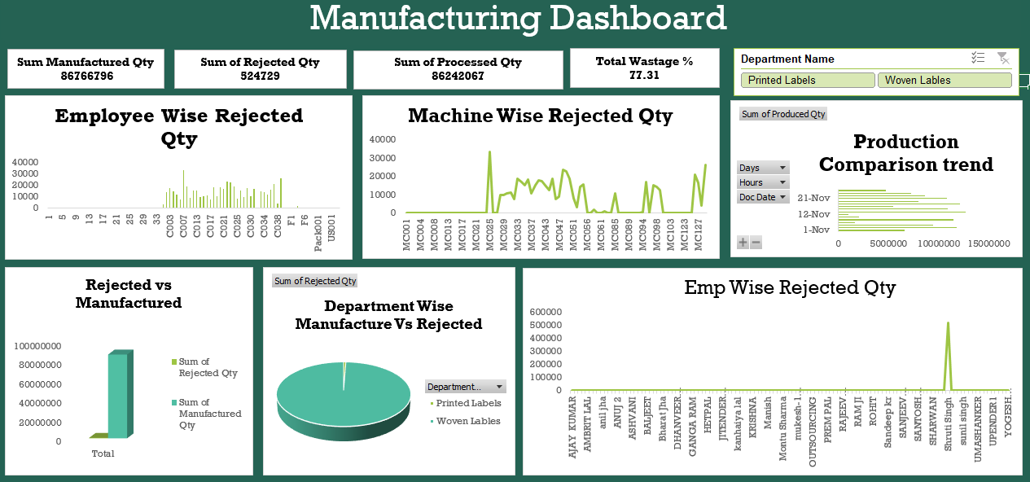
Excel Dashboard

Slide 10
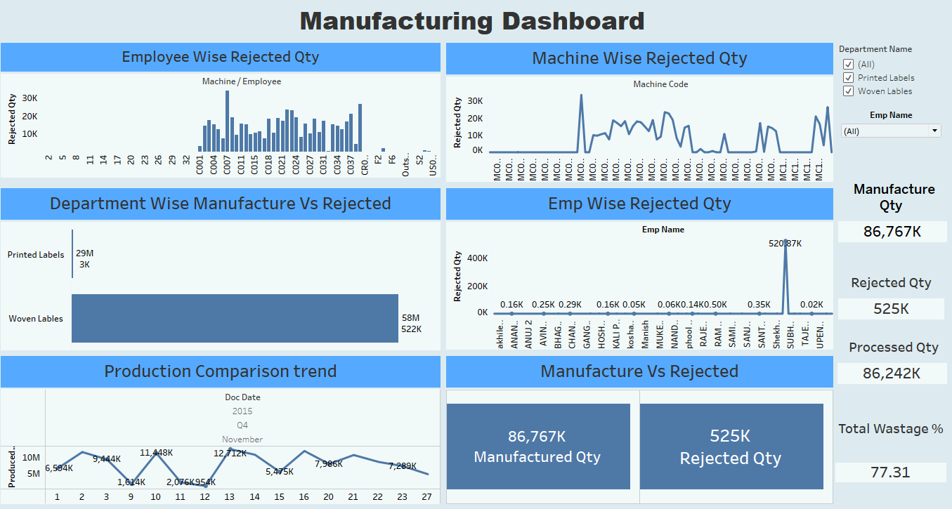
Tableau Dashboard

Slide 11
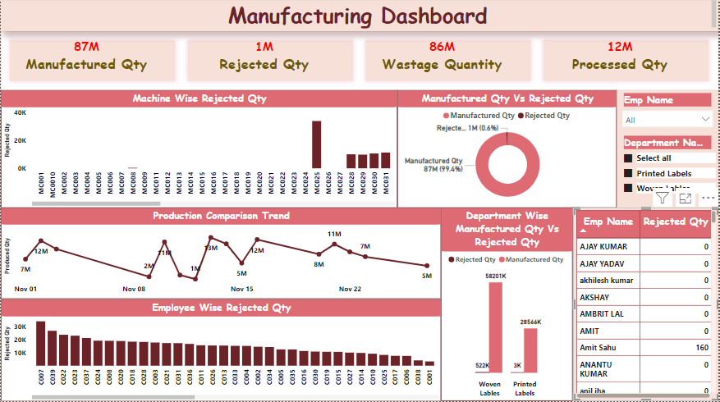
Power Bi Dashboard

Slide 12


